Slide 1
Discourse & Narrative Methods: Language in the Aviation Industry
Andy Chin

Slide 2
Why am I here today?
What is the relationship between language and aviation industry?

Slide 3
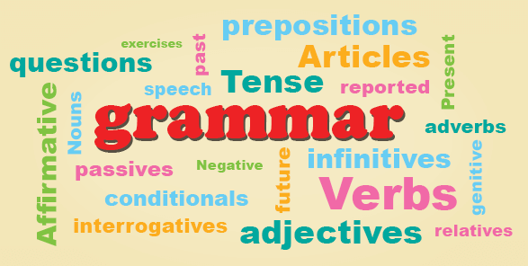
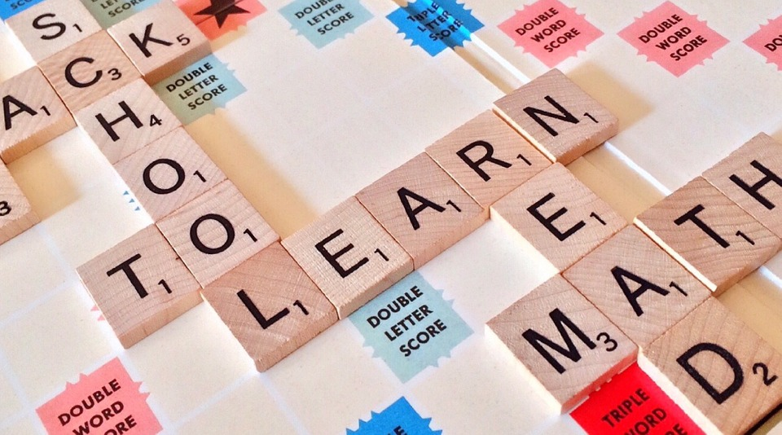
What is LANGUAGE meant to you?

Slide 4
What is language?

Slide 5
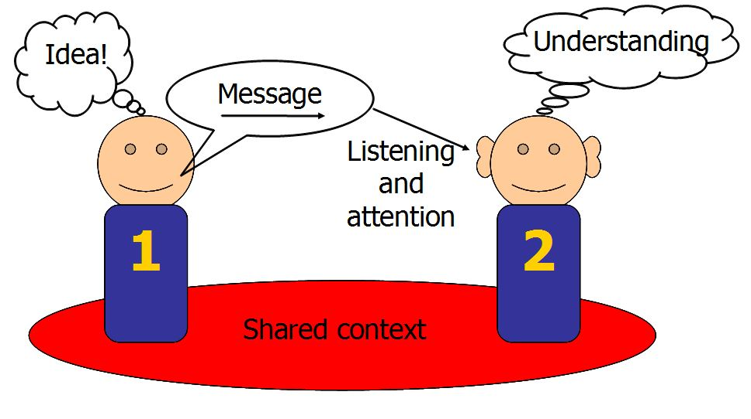
Functions of human language
http://edinburgh-lothian-mobile-speech-therapy.co.uk/wp-content/uploads/2012/12/Communication-Chain.jpg

Slide 6
What is important in human communication?
How do you pronounce the following alphabets?
S, F, R, L, W, X
How about when you talk to the building attendants?
Communication is more than correct grammar, correct pronunciation and correct spelling
To get the message across

Slide 7
Discourse and Narrative
Understanding of meanings of utterances require context

Slide 8
Case 1
When John and Jane walk on the street. John saw a big hole in front of them, and he said to Jane, “there is a hole ahead”.
What is the intention of John when saying “there is a hole ahead”?

Slide 9
Case 2
Where is my lunch?

Slide 10
In aviation industry
Communication (with language) is very important
Miscommunication (wrong encoding and wrong decoding of messages) can cause people’s lives

Slide 11
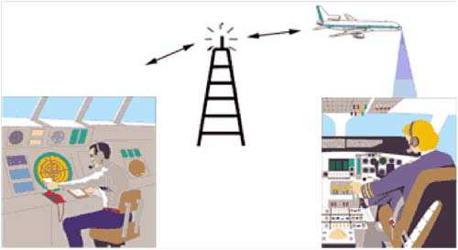
Language in aviation industry
Let’s use communication between pilots and air-traffic controller as an example

Slide 12
How busy is the sky above us?

Slide 14
Aviation communication
What language is used?
Pilots come from different parts of the world

Slide 15
Always use proper pronunciations?

Slide 16
卅蚊改套餐 (change to a set with $30)
[saa1-aa4 man1]
三蚊改套餐 (change to a set with $3)
[saam1 man1]

Slide 17
Different interpretation for the same sentence

Slide 18
Surface vs. underlying meaning

Slide 19
Cultural issues

Slide 20
Accents of English

Slide 22
To sum up,
The investigation of language in the context of aviation, where very much depends on communicative success, may make the linguist and the communicative practitioner most sharply aware of and sensitive to the processes and problems involved in linguistic behavior in any field of social interaction. (p.84)

Slide 24
Applications of studies of languages

Slide 25
Auto-correction: Use of “errors”

Slide 26
Forensic linguistics

Slide 27
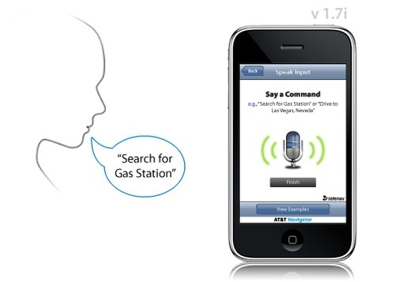
Speech recognition
Homophony (同音現象)

Slide 28
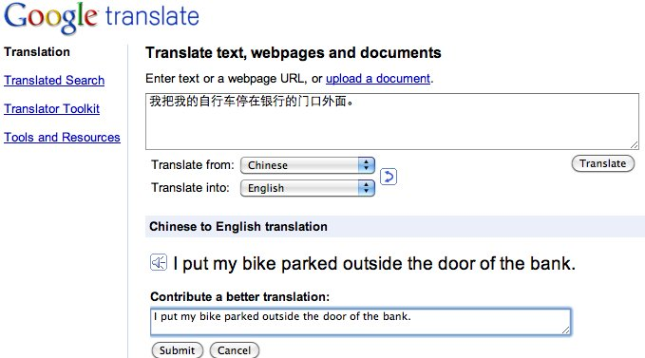
Machine Translation

