Slide 1


Staffordshire University Degrees
Offered by SCOPE at City University of HK
BSc (Hons) Computing Science
BSc (Hons) Information Systems
BSc (Hons) Business Information Technology

Slide 2
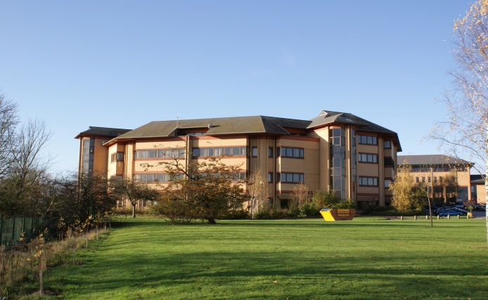
Computing at Staffordshire University
One of the first Computing courses in UK
Has been ranked 7th in the UK according to certain measures (above Cambridge, Oxford and Imperial College!*)
Over 1000 graduates world-wide per year
*http://www.computerweekly.com/Articles/2004/11/04/206369/table-helps-bosses-rate-it-courses.htm

Slide 3

Programme Features
Offered since 1995 with more
than 2,000 graduates
Three different awards are
offered to cater for student needs in different subject
areas
Specially designed for part-time working adults
Emphasis on both academic and work-related skills
Provides students with the opportunity to apply a
theoretical framework to their Final Year Projects in
selected areas

Slide 4

HKCAAVQ Accreditation
These programmes have been accredited by Hong Kong Council for Accreditation of Academic and Vocational
Qualifications (HKCAAVQ) as locally accredited top-up degree programmes to reach HKQF Level 5, which is
equivalent to the standing of bachelor’s degrees offered by local universities in Hong Kong.
QF Level: 5
QF Ref: 10/000642/5 (CS), 10/000643/5 (BIT), 10/000644/5 (IS)
Validity: From June 1, 2010 to May 31, 2018

Slide 5
Benefits
(a) Employment
The degree qualification is formally recognized by the Government for
employment purposes within the Civil Service including the attainment of
Qualifications Register at QF Level 5 for graduate posts.
(b) Considered to be formally quality assured by the Education Bureau
The programmes are listed in iPass.edu.hk of the Education Bureau of
Government, the list of programmes that are officially recognized by the
Government and the student numbers are reported in the account for higher
Education capacity of the territory.

Slide 6
Programme Structure
240 Credits
27-month part-time top-up degree programme
The programme consists of 13 taught modules including, 8 level V and 5 level VI modules, and a final year project (counted as 3 modules).
Taught over 2 years spanning 4 Semesters and 2 Summer Terms
Medium of instruction: English

Slide 7
Programme Structure
180 Credits
24-month part-time top-up degree programme
The programme consists of 9 taught modules including 4 level V and 5 level VI modules, and a final year project (counted as 3 modules).
Taught over 2 years spanning 4 Semesters and 1 Summer Terms
Medium of instruction: English

Slide 8
BSc (Hons) Computing Science
Level V modules (240 credits) – common with IS and Business IT
Electronic Commerce
Open Source Web programming
Professional & Enterprise Development
Object-Oriented Methods
Level V modules
Database Systems
Data Management
Hardware and Software Systems and Networks
Principles and Practices of Software Production

Slide 9
BSc (Hons) Computing Science
Level VI modules
Advanced Database Systems
Advanced HCI and Usability
Distributed Computer Systems
Project Management
Knowledge Management in Organizations
CS Route Project (3 modules)

Slide 10
BSc (Hons) Information Systems
Level V modules – as Computing Science & Business IT
Level V modules
Database Systems
Data Management
      Service Management and ITIL
      Information System Organizations and Management
      Level VI modules
Advanced Database Systems
      Advanced HCI and Usability
      Strategic Information Management
      Project Management
      Knowledge Management in Organizations
      IS Route Project (3 modules)

Slide 11
BSc (Hons) Business Information Technology
Level V modules – as Computing Science & Information Systems
Level V modules
Database Systems
Data Management
      Service Management and ITIL
Information System Organizations and Management
Level VI modules
Strategic Entrepreneurship and Innovation
Advanced HCI and Usability
      Project Management
      Strategic Information Management
      Applied Communications Technology
      BIT Route Project (3 modules)

Slide 12
What is the Difference?
Computing Science
  More accent on operating systems & hardware
  More software design & development
  FYP has more implementation bias
  Graduates are ‘solution developers’
Information Systems
  More accent on developing IS in organisations
  More systems analysis & design, database & web design
  FYP has analysis & design/project management bias
  Graduates are ‘system implementers’

Slide 13
What is the Difference?
Business Information Technology
  More accent on use of IT in business
  More IT management & planning
  More on understanding business processes
  FYP has business application of IT bias
  Graduates are ‘business problem solvers’

Slide 14
Who can apply?
Entry Point 1 (240 credits)
Graduates of Diploma/higher certificate in Computing or IT related disciplines with 3 years relevant working experience or those with equivalent qualification
Entry Point 2 (180 credits)
Graduates of Associate Degree/ Higher Diploma in Computing or IT related disciplines or those with equivalent qualification

Slide 15
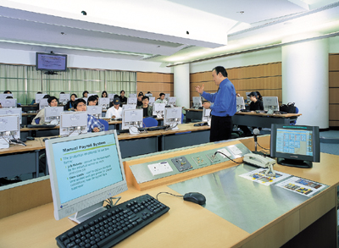
Class Pattern
Lectures and tutorials/ workshops
Around 6-9 hours per week
Classes will normally be held during Fridays or Saturday afternoon/ evenings and/ or Sundays (normally for make-up classes)
Some tutorials may also be held on weekday evenings
Weekday evenings: from 6:45/ 7pm to 10pm
Saturdays: from 2:00 to 5:00pm and 6:00 to 9:00pm

Slide 16
Programme Fees –Entry point 1
HK$137,600 for 240 credits (by 6 instalments)
1st - HK$18,400
2nd – HK$25,440
3rd – HK$25,440
4th – HK$17,440
5th – HK$25,440
Final – HK$25,440
*Graduation Fee : HK$400

Slide 17
Programme Fees – Entry point 2
HK$ 103,200 for 180 credits (by 5 instalments)
1st – HK$17,440
2nd – HK$17,440
3rd – HK$17,440
4th – HK$25,440
Final – HK$25,440
*Graduation Fee : HK$400

Slide 18

Education Subsidies and Loan
1) Continuing Education Fund (CEF) (持續進修基金)
Modules: Strategic Entrepreneurship and Innovation, Strategic Information Management, and Project Management.
Reimburse 80% of fees, subject to a maximum sum of
HK$10,000, on successful completion of the course(s) in the
programme
2) Non-means Tested Loan Scheme (免入息審查貸款計劃)

Slide 19
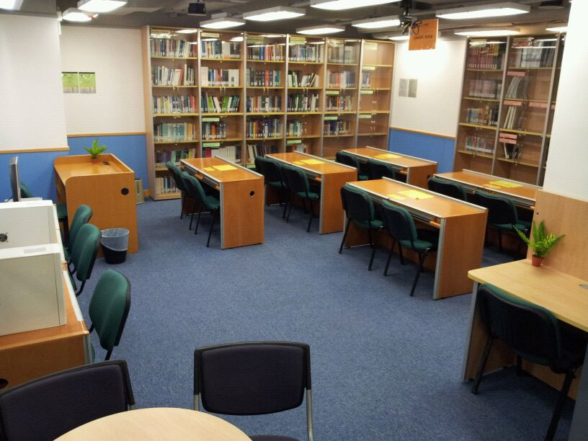
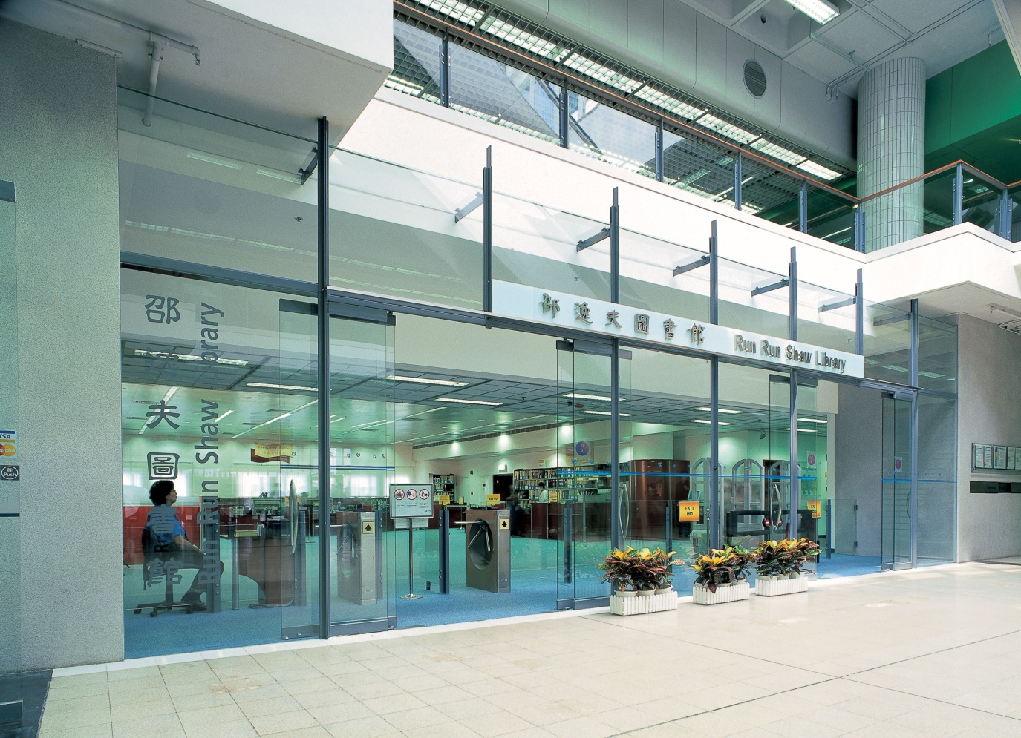
Learning Resources at SCOPE
Use of City U’s Library facilities
Use of City U’s Computing Services Centre
(including an email account with 50 MB quota)
Use of SCOPE’s resource area located at TSTE
Wifi access in common areas like canteens, library and
Lecture theatres of Academic I Building

Slide 20
Application Deadline
14 May 2016 (Past graduates - Entry point 1)
30 June 2016 (Current year graduates – Entry point 2)

Slide 21
Q & A?

