Slide 1


Your Campus Life at
CityU-SCOPE !
Year 2016

Slide 2

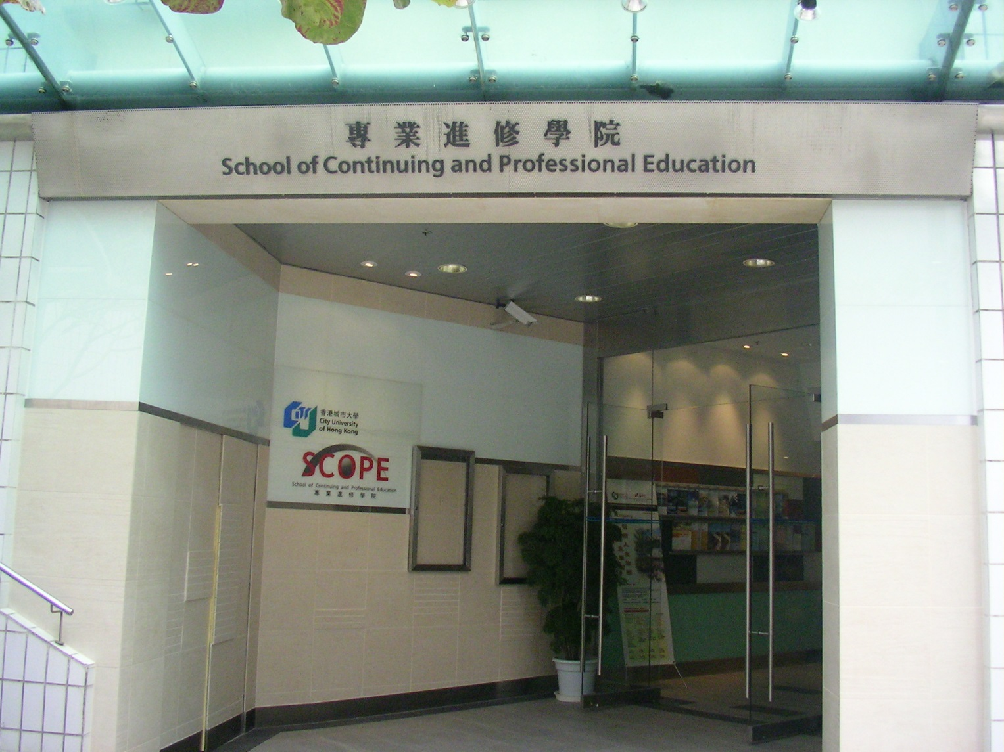
Welcome to the family of CityU-SCOPE!
Welcome Aboard

Slide 3
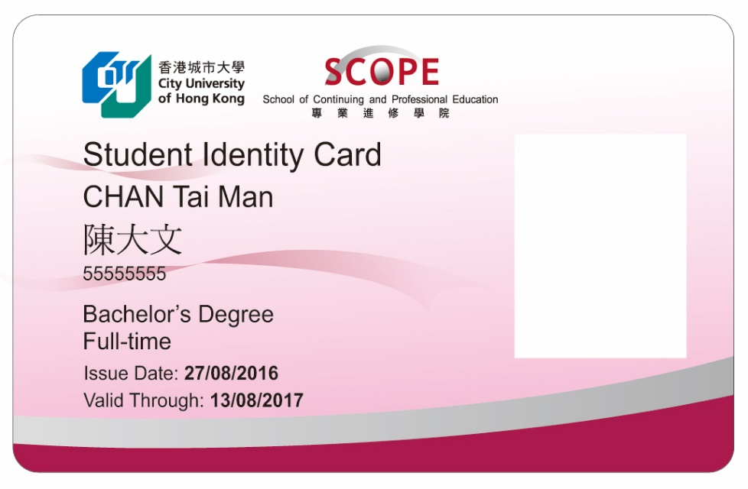
Students of CityU-SCOPE studying non-local postgraduate & bachelor’s degree, advanced diploma, progression diploma and designated professional programmes can enjoy many of the services and facilities in the CityU campus and its vicinity.
Student Identity Card
CityU-SCOPE Student Identity Cards are issued for these students to access University & CityU-SCOPE’s facilities and services delivered electronically.

Slide 4
With CityU-SCOPE Student Identity Card,
You can access
Run Run Shaw Library
Computing Services Centre
SCOPE Study Area / Reference Area
CityU restaurants during non-peak hours
CityU Student Canteens
You are eligible to
Apply for Hang Seng CityU Credit Card
(Website: www.hangseng.com)
* SCOPE full-time students aged below 25 are eligible for MTR student fares

Slide 5
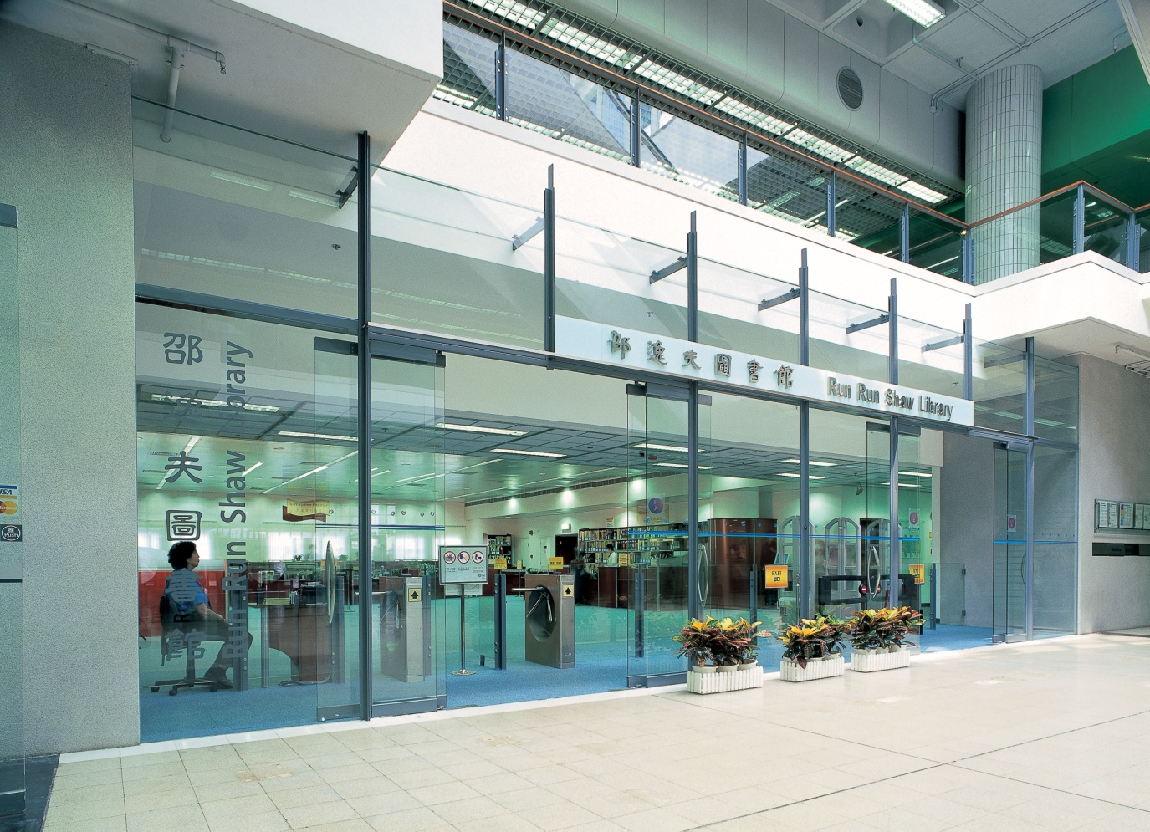
Run Run Shaw Library

Slide 6

Run Run Shaw Library
Level 2 (Yellow and Red Zones) & Level 3 , Academic 1, CityU
Circulations:
Over 1,067,400 volumes of print books
Over 2,510,700 titles of electronic books
Around 218,600 volumes of bound periodicals
About 1,700 print serials titles
An expanding number of electronic databases, e-journals and media resources
Facilities:
The total number of seats available is around 2,417
Information Space and the Oval fitted with over 200 PC Workstations
A number of photocopiers
In-house audio-visual equipment
Services:
e-Resources (E-Journals; Databases; E-Books; E-Reference Works…..)
Loan services for Books and Media Resources
Library classes
Printing and photocopying services at cost
Website: www.cityu.edu.hk/lib

Slide 7
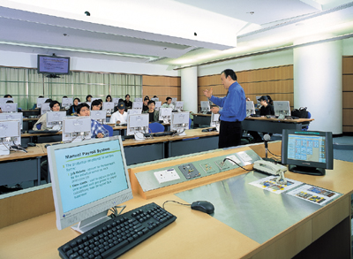
Computing Services Centre (CSC)

Slide 8
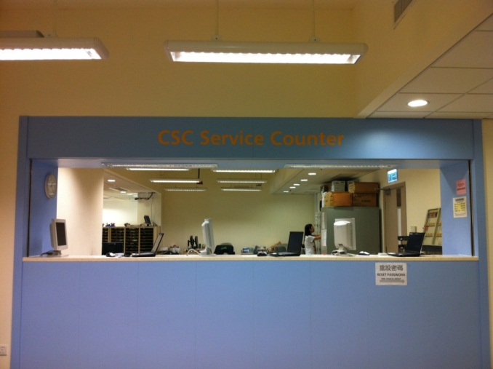
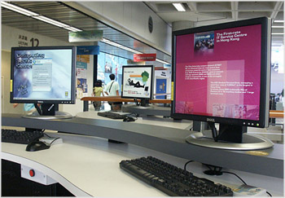
Computing Services Centre
4/F, Li Dak Sum Yip Yio Chin Academic Building
Facilities:
Student terminal area
Computers around campus
Service Counter for students
Express Terminals
Electronic Services:
CityU e-Portal and Canvas – centrally support e-learning platform where students can get learning materials provided by instructors and communicate with teachers and classmates.
Electronic Mail (CityU Office 365) – you can enjoy :
A modern messaging solution featuring email, calendar, contacts.
Web and mobile ready hence accessible from popular web browsers and mobile devices.
50GB disk storage space.
Student LAN – adopted a set of software that are centrally supported for teaching, learning and research purposes.
Website: www.cityu.edu.hk/csc

Slide 9
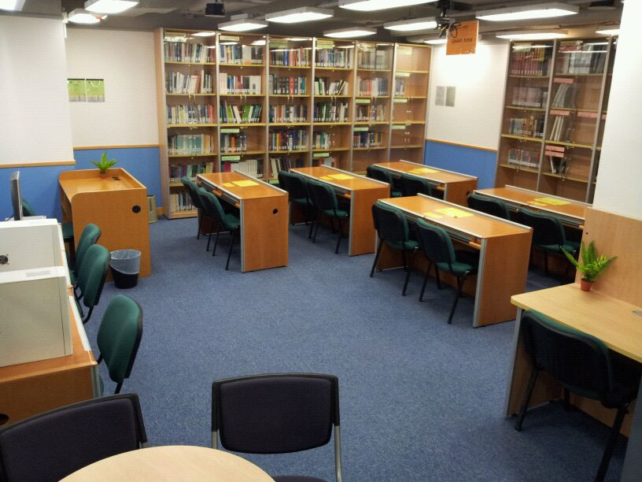
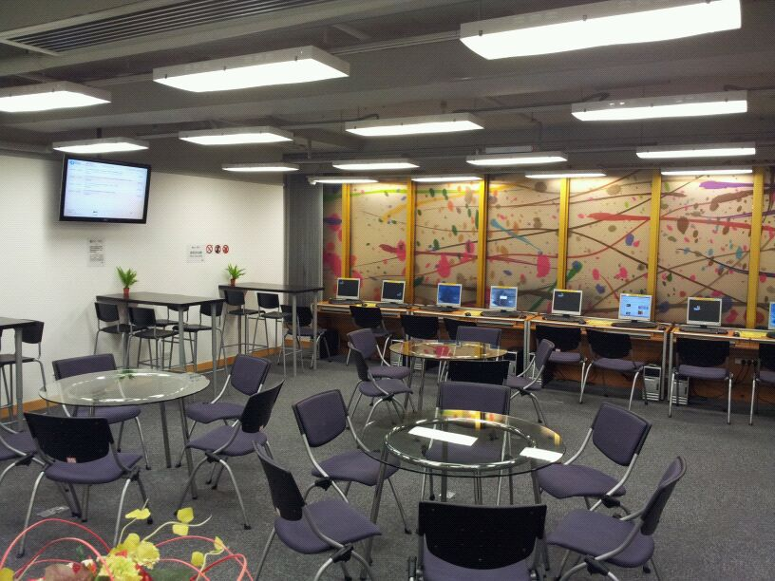
CityU-SCOPE Reference Area and Study Area

Slide 10
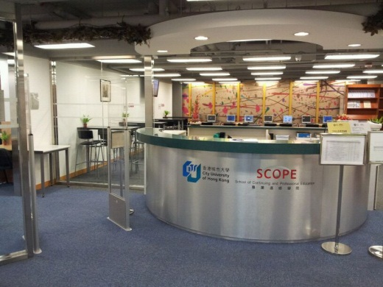
CityU-SCOPE Facilities and Services
CityU-SCOPE Reference Area and Study Area
located at TSTE Learning Centre
provides PCs with Internet access and space for study and discussion
Online resources
Available from overseas universities for most non-local postgraduate
and top-up degree programmes
Wi-Fi Network
A high speed wireless local area network available at CityU-SCOPE Kowloon Tong Office, TSTE Learning Centre and Admiralty Learning Centre;
Wi-Fi Access Points has also been established at most common area inside CityU main campus

Slide 11
FAQs
Am I eligible to use CityU Library and how many
items can I check out ?
You are entitled to access CityU Library and its facilities if you are a CityU-SCOPE Student Identity Card holder.
You may borrow up to 10 items for 30 days and also use your loan quota to borrow Media Resources (in-house only) and Semi-closed (Reserve)/Closed Access Material.
What should I do if my EID activation is not successful or if I forget the Password ?
If you are a CCCU AD or CityU graduate, you do not need to activate your EID. In case of unsuccessful activation, please go to CSC Help Desk in person with your CityU-SCOPE Student Identity Card to reset your password.

Slide 12
FAQs
Where can I access the wireless internet service and how can I obtain the security key for Wi-Fi service ?
You can enjoy Wi-Fi connection at the below locations :
- CityU-SCOPE Kowloon Tong Office in the Academic Exchange Building
- CityU Garden Café
- Tsim Sha Tsui East Learning Centre
- Admiralty Learning Centre
A security key will be sent to your CityU-SCOPE email account about two weeks after your EID is activated.
** CityU Wi-Fi within the campus is not available for CityU-SCOPE students
However, you may try to connect to Wi-Fi.HK via CityU when you are on CityU campus. Wi-Fi.HK is offered by the public and private sectors completely free or free for a certain period of time in Hong Kong.

Slide 13
FAQs
Do CityU and CityU-SCOPE provide printing and photocopying services? Can I pay by Octopus Cards ?
- In CityU campus, you can find the Octopus Card-operated photocopiers and printers at various locations within the Run Run Shaw Library and in Computing Services Centre (CSC).
CityU-SCOPE also has the Octopus Card-operated photocopiers and printers placed at its Kowloon Tong Office, Admiralty Learning Centre and Tsim Sha Tsui East Learning Centre.
There is no free printing quota for CityU-SCOPE students.

Slide 14
Enjoy Learning at
CityU-SCOPE !

